Slide 1

Knowledge Graph Creation from Text with LLMs
Ar Pazari and Didarbek Baidaliyev
Technische Universität München
TUM School of Computation, Information and Technology

Slide 2
Knowledge Graph Creation from Text with LLMs
Outline :
Introduction and Motivation
Problem Statement
Approach
Evaluation
Conclusion and Next Steps

Slide 3
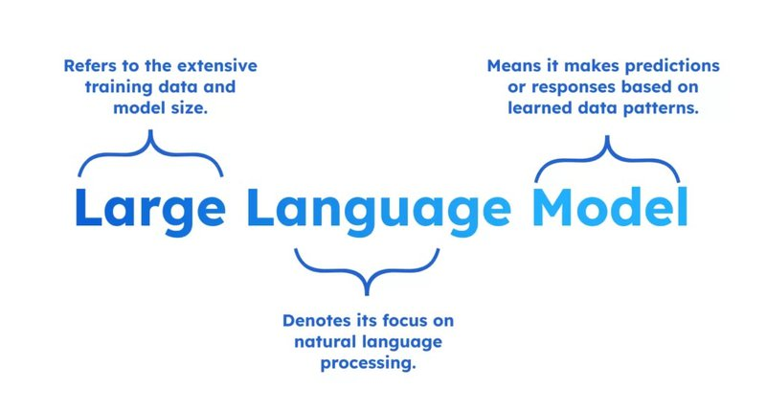
Introduction and Motivation
What are LLM’s and why are they important for us ?

Slide 4
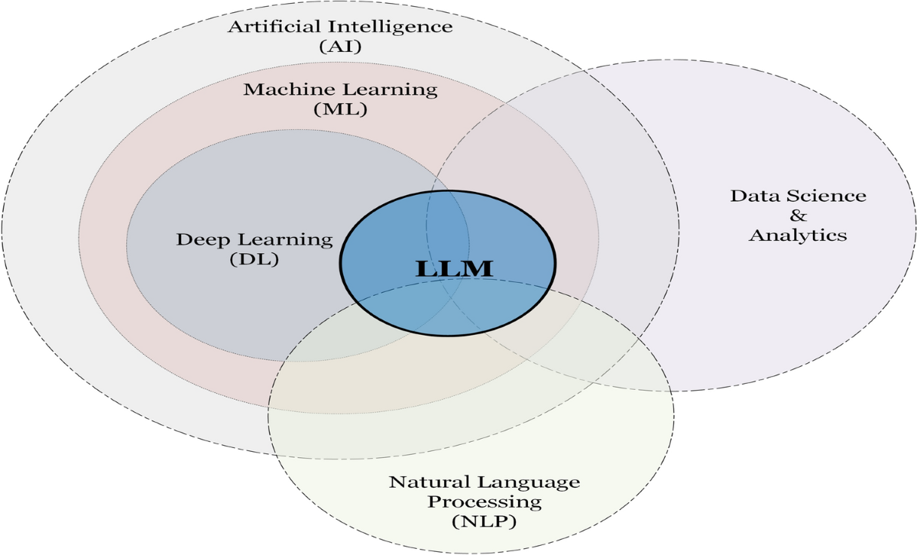
Introduction and Motivation
What are LLM’s and why are they important for us ?

Slide 5
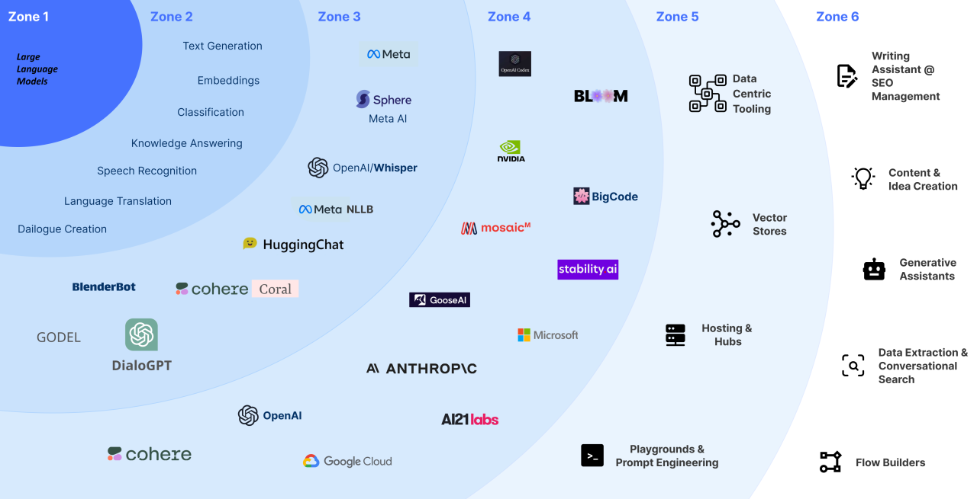
Introduction and Motivation
What are LLM’s and why are they important for us ?

Slide 6
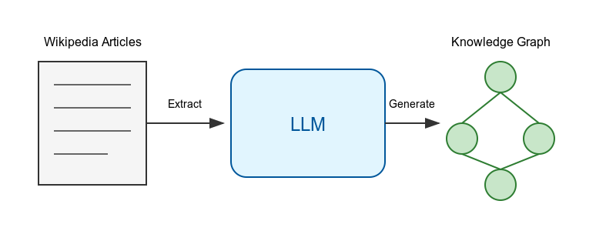
Problem statement
Transform unstructured Wikipedia articles into structured knowledge graphs using LLM’s
Key Components :
Input
Process
Output
Main Challenges :
Accuracy of Triple Extraction
Prompt Design for LLM’s
Ontology Alignment

Slide 7
Sources
Slide number 3 - Link
Slide number 4 - Link
Slide number 5 - Link
Slide number 6 - Created using AI tools

